Slide 1
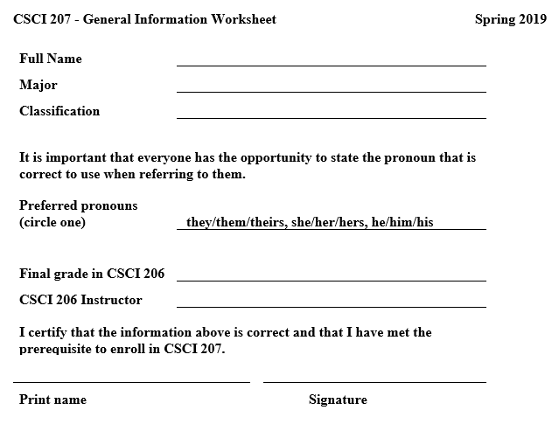
General Information Worksheet

Slide 2
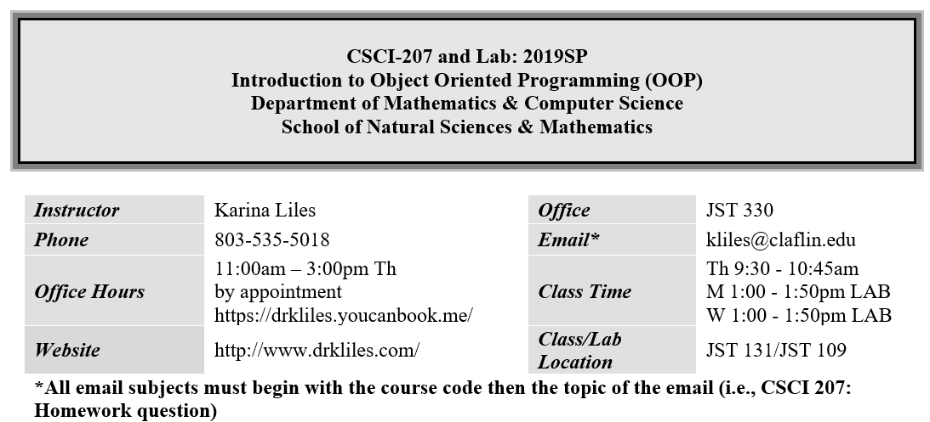
Syllabus

Slide 3
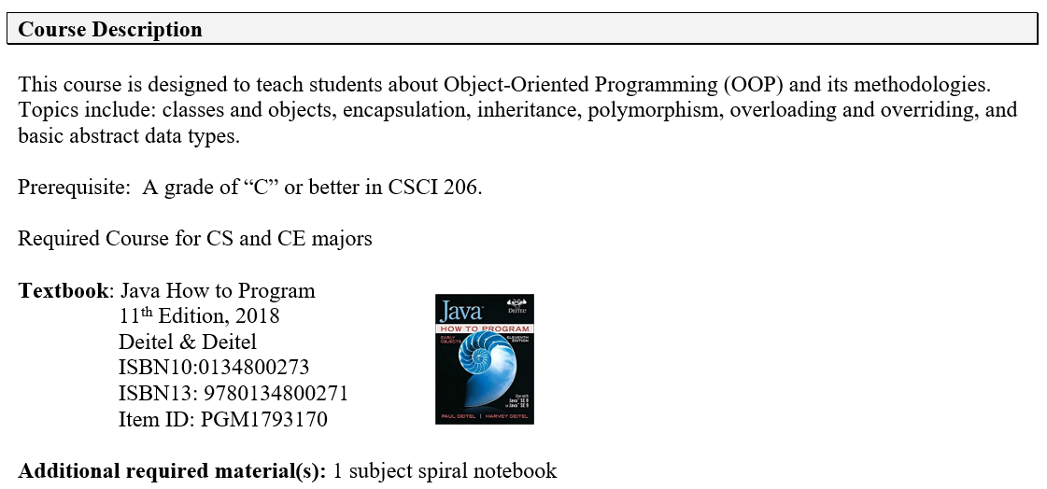

Slide 4
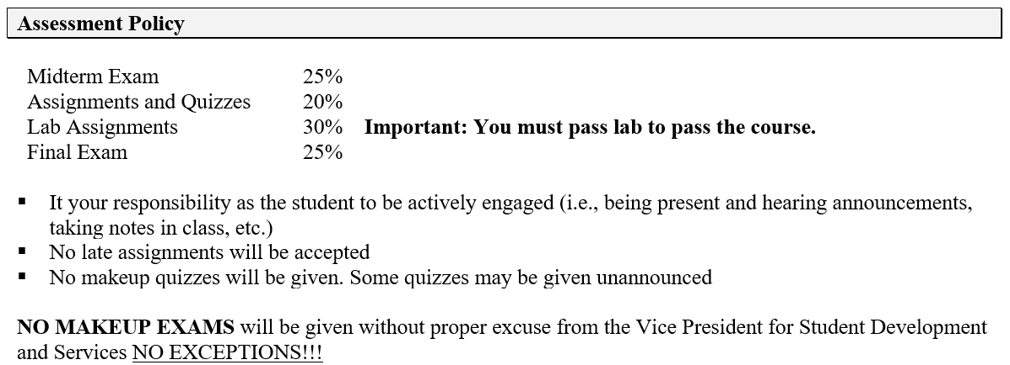

Slide 5
Lecture Day (Tuesdays)
5 min - Setup
10 min – Quiz (Chapter reading)
45 min - Lecture
15 min - Coding notebook

Slide 6
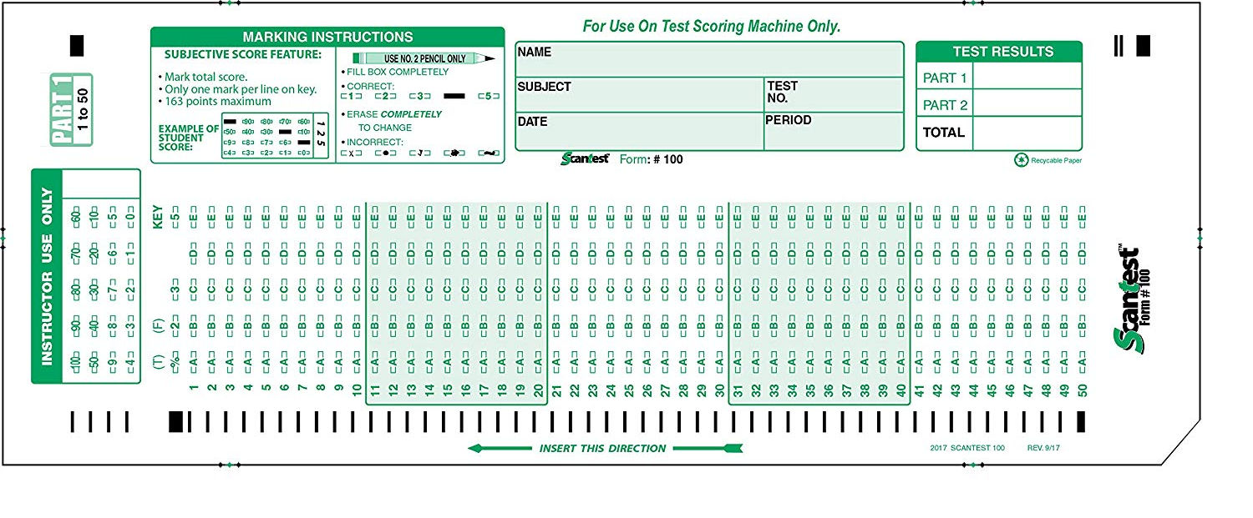
Quiz (Chapter Reading)
You will be given reading assignments and homework problems to prepare you for each quiz
Homework assignments will not be collected for grading
Quizzes will be given every Tuesday at the beginning of class
Pay attention to class announcements for changes and updates
Check Moodle for readings and problems
2 lowest grades will be dropped
You will need to use a #2 pencil

Slide 7
Lecture
Lectures will cover topics from readings
The readings before class will give you sufficient background to better understand lectures
Additional quizzes and assessments may be given on material from lectures

Slide 8
Coding Notebook
Title
Date
Programming Task
Use page 1 to keep a record of your grades
Handwritten Code
Notes from classmates

Slide 9
Title
Programming Task
Date
Hello world
December 8, 2018
Write a program that prints Hello World.
public class HelloWorld{
public static void main(String []args){ System.out.println("Hello World");
}
}
Handwritten Code
Notes from classmates
Alternate code:
String phrase = “Hello World”;
System.out.println(phrase);

Slide 10
Code Day (Thursdays) – Student Led
20 min - Discussion of Tuesday code
35 min - Code challenge
20 min - Whiteboarding of Lab Code

Slide 11




Discussion of Tuesday Code
Class begins with 4 students writing their coding solution on the white board
Students are to give feedback on code and have meaningful discussions
Add notes from discussions to your coding notebook
You may also update your code
public class HelloWorld{
public static void main(String []args){ System.out.println("Hello World");
}
}
public class HelloWorld{
public static void main(String []args){ System.out.println("Hello World");
}
}
public class HelloWorld{
public static void main(String []args){ System.out.println("Hello World");
}
}
public class HelloWorld{
public static void main(String []args){ System.out.println("Hello World");
}
}

Slide 12
Code challenge
Extra credit opportunities
I will announce a programming task and details of the challenge (i.e., each student comes up to write a line of code, teams compete for points by taking turns writing lines of code, etc.)

Slide 13

Whiteboarding of Lab Code
A student will write out and explain lab assignment from previous week
public class HelloWorld{
public static void main(String []args){ System.out.println("Hello World");
}
}

Slide 14
Grading for coding activities
Everyone must complete code for each activity at least once before others can repeat. You must complete the average number of times as the class to receive satisfactory credit.
For example, if students complete 5 whiteboarding activities, you must complete at least 5 for a satisfactory grade.

Slide 15
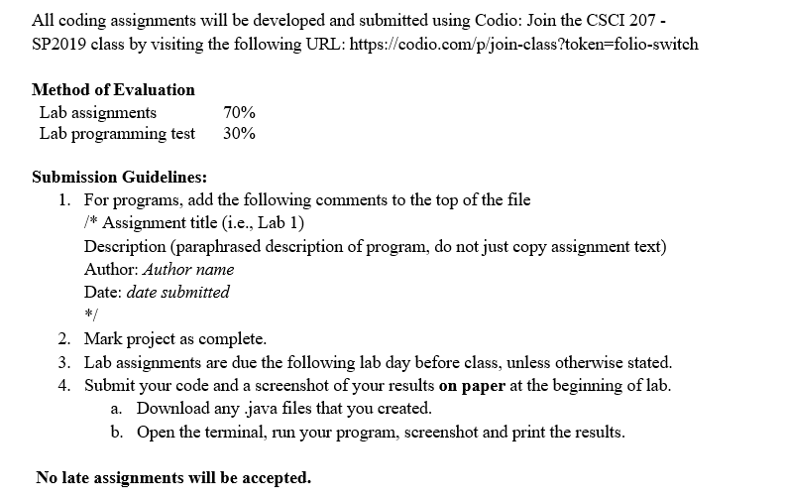
Lab

Slide 16
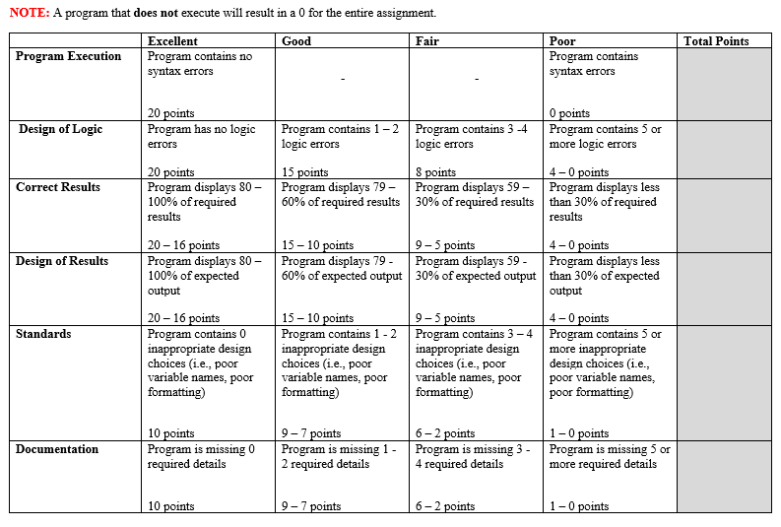

Slide 17
Homework
Read Chapters 4 - 6
Problems: 4.8, 4.9, 4.16, 5.9, 5.10, 5.11, 5.12, 6.4, 6.5, 6.16

Slide 18
Exercise
What is the product of the odd integers from 1 to 15?

Slide 19
Code challenge
Write an application that calculates the product of the odd integers from 1 to 15.

